Slide 1

Olympiades FANUC Ingénieur
Équipe CentraleSupelec
CARVALHO BÜRGER Karoline
DE JESUS RODRIGUES Tiago
ELLER CRUZ Rafael
NOGUEIRA Rafael Accácio

Slide 2

Summary:
1 – Problem description;
2 – Solution description;
2.1 – Robot choice;
2.2 – Robot and fixtures positioning;
2.3 – Robot trajectory and programming;
2.4 – Robot cell inputs and outputs;
2.5 – Operational safety considerations;
3 – Results and conclusion.

Slide 3

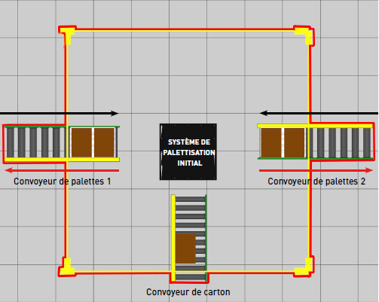
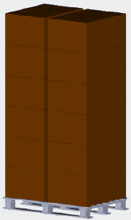
1 – Problem description
Project objective:
Optimize the present distribution of a palletizing system of a factory
Original Surface
Pallet and boxes

Slide 4
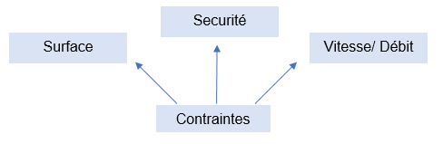
1 – Problem description
Main constraints to be followed:
Halve original surface (3600 x 3600 mm)
Data provided: dimension of the fixtures, velocity, flow
Safety: DCS

Slide 5
2 – Solution description
2.1 – Robot choice;
2.2 – Robot and fixtures positioning;
2.3 – Robot trajectory and programming;
2.4 – Robot cell inputs and outputs;
2.5 – Operational safety considerations.

Slide 6
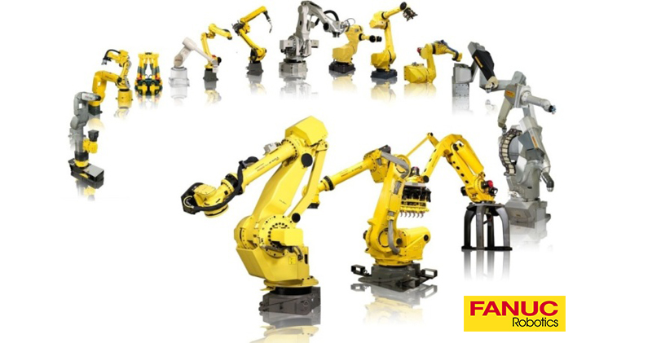

2.1 – Robot choice
We need to analyze the problem specifications .

Slide 7
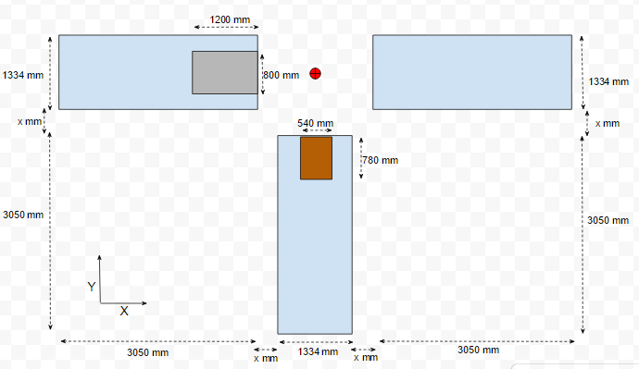
2.1 – Robot choice
Robot application => Palletizing;
Payload => Grip + Box ( 70 kg )
Range of action
1812.19 mm

Slide 8
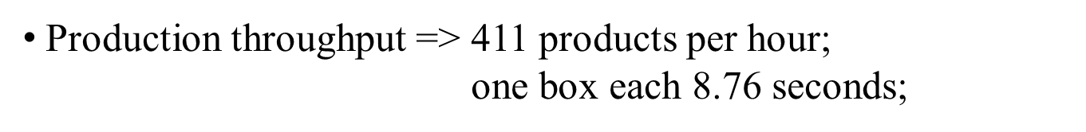
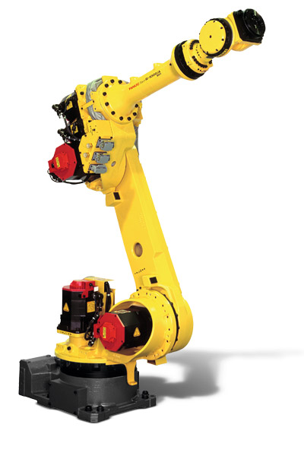
2.1 – Robot choice
The chosen one…
R-1000iA/80H

Slide 9
2 – Solution description
2.1 – Robot choice;
2.2 – Robot and fixtures positioning;
2.3 – Robot trajectory and programming;
2.4 – Robot cell inputs and outputs;
2.5 – Operational safety considerations.

Slide 10
2 – Solution description
2.1 – Robot choice;
2.2 – Robot and fixtures positioning;
2.3 – Robot trajectory and programming;
2.4 – Robot cell inputs and outputs;
2.5 – Operational safety considerations.

Slide 11
2 – Solution description
2.1 – Robot choice;
2.2 – Robot and fixtures positioning;
2.3 – Robot trajectory and programming;
2.4 – Robot cell inputs and outputs;
2.5 – Operational safety considerations.

Slide 12
2 – Solution description
2.1 – Robot choice;
2.2 – Robot and fixtures positioning;
2.3 – Robot trajectory and programming;
2.4 – Robot cell inputs and outputs;
2.5 – Operational safety considerations.

Slide 13
Resultats

Slide 14
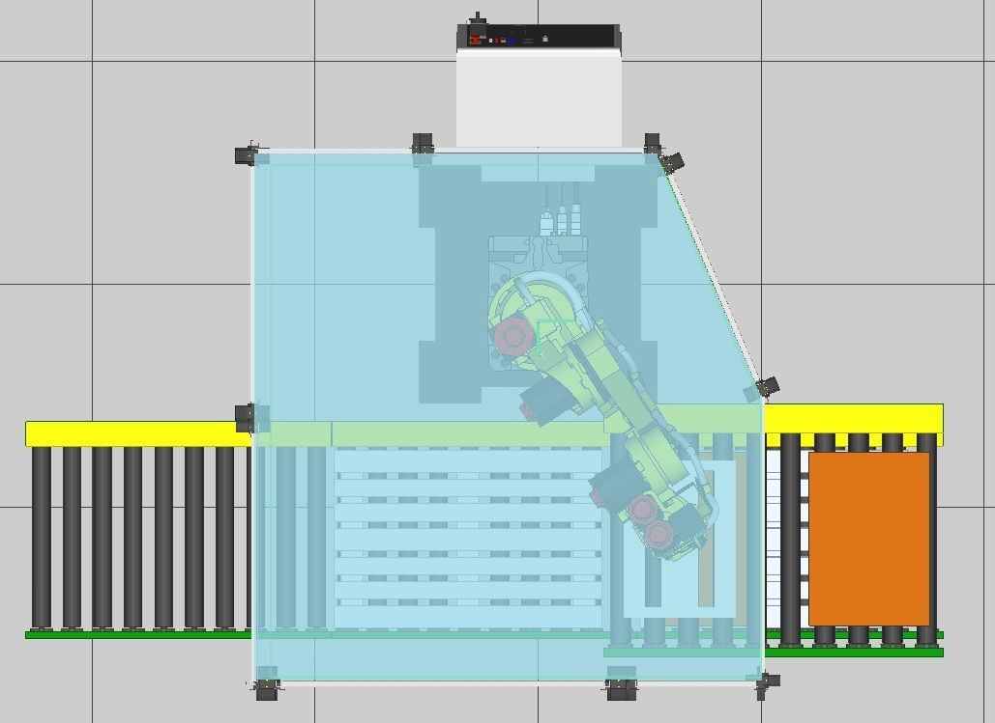
Surface de l’îlot

Slide 15
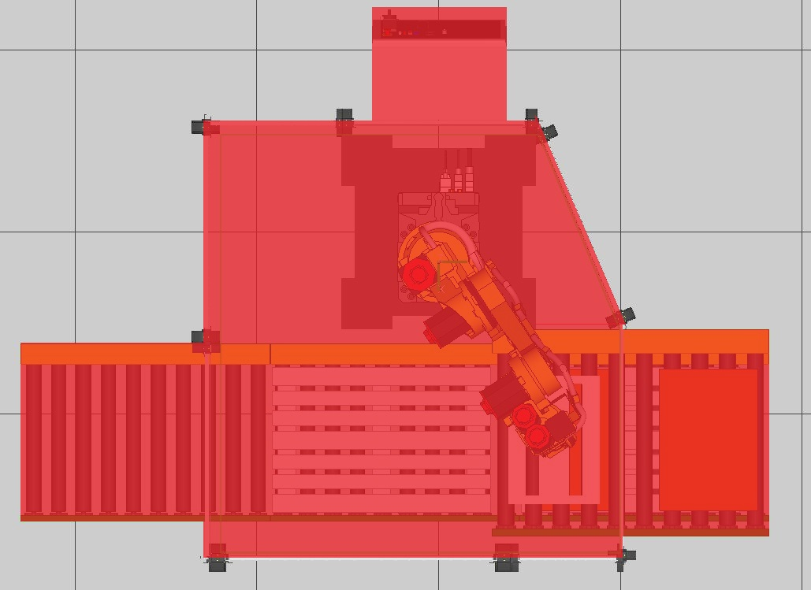
Surface de l’îlot

Slide 16
Cadence de production

Slide 17
Prévision Budgétaire
Élements | Prix
Robot R-1000iA | 45000 e
Fonction de sécurité DCS | 2000 e
Préhenseur à ventouses | 700 e
Total | 47700

